Slide 1
Passive VS. Active
SC.6.L.14.3 Recognize and explore how cells of all organisms undergo similar processes to maintain homeostasis, including extracting energy from food, getting rid of waste, and reproducing.

Slide 2
Prior Knowledge
1. What is a cell?
The smallest unit of life that can function independently.
2. What is homeostasis?
The cell's ability to regulate its internal conditions as to remain stable and relatively constant.

Slide 3
Preview
http://www.schooltube.com/video/b56b9e33f44540b89648/
Notes:
0:40 Focus on this information that will be addressed, again, during the PowerPoint.
1:07 – 1:30 Skip this portion related to facilitated diffusion
1:30 State that ATP is what the cells use for energy
3:26 Stop video

Slide 4
Directions
On sticky notes, please document your responses to the following inquiries.
Make sure to justify your response.

Slide 5
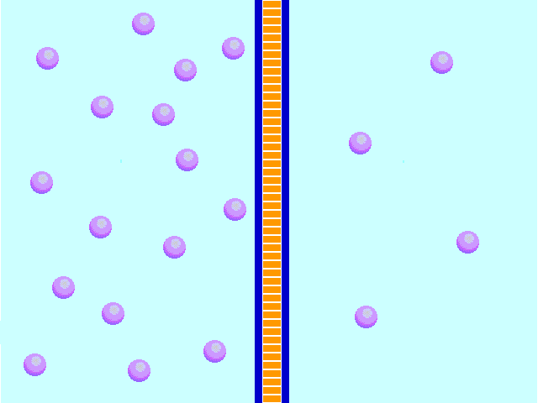
Passive Transport
On your sticky note, describe what you think is occurring to the molecules in the following image.
http://www.tnmanning.com/HTMLobj-1852/aniGif.gif
Notes:
At this point, students are just making predictions. Any answer is fine. Ask probing questions provided on CPLAMS in the guiding practice.

Slide 6
Passive Transport
What is passive transport?
Describe this process using specific terminology.
The movement of particles across a cell membrane without the use of energy.
Diffusion: The movement of molecules from an area of high concentration to low.
Osmosis: The diffusion of water through a semi-permeable membrane.
http://www.biologycorner.com/resources/diffusion_red.JPG
Notes:
Include discussion on items such a tea bag diffusing the contents throughout water or odor spreading throughout a room after being sprayed. Ask students how the process of osmosis might be implemented in the cleaning of water.

Slide 7
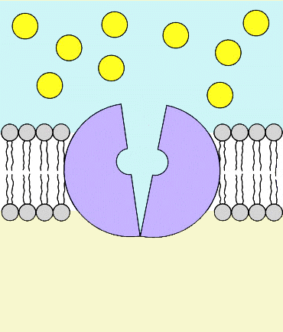
Active Transport
On your sticky note, describe what you think is occurring to the molecules in the following image.
http://iws.collin.edu/biopage/faculty/mcculloch/1406/outlines/chapter%208/FACILDIFF.GIF
Notes:
At this point, students are just making predictions. Any answer is fine. Ask probing questions provided on CPLAMS in the guiding practice.

Slide 8
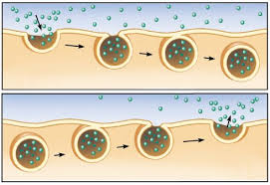
Active Transport
What is active transport?
Describe this process using specific terminology.
The movement of particles against the concentration gradient and requires the use of energy.
Endocytosis: cell takes in large particles by engulfing them
Exocytosis: - cell gets rid of particles, opposite of endocytosis
http://t2.gstatic.com/images?q=tbn:ANd9GcRIeYMk7ffMyQaY_iLuQc0_l4CyAVlEGSwzKoM0FTf-N-Vgz1IJ
Notes:
If students are confused about the concentration gradient, relate the gradient to the amount of a specific color upon a color swab at a warehouse store. https://www.google.com/url?sa=i&rct=j&q=&esrc=s&source=images&cd=&cad=rja&uact=8&docid=t84JECQz_fBmHM&tbnid=RCsm10yclYy67M:&ved=0CAUQjRw&url=http%3A%2F%2Finteriordesignhq.com%2Fworking-with-paint-swatches%2F&ei=TczGU8-RLPHJsQTNpIGYBA&bvm=bv.71126742,d.cWc&psig=AFQjCNFxJRxtiUtf4z-UKMnvZ-tUYNDghQ&ust=1405623753967127

Slide 9
Activity Extension
Construct a semi-concrete model of each form of transport occurring (in the form of a labelled illustration.) Individually, you should choose one of the previously listed examples or create an original example.
Notes:
Provide students with the rubric to reference for this portion.

